Slide 1


MICROSOFT EMS COMMUNITY
WELCOME TO
CloudHour
We will start shortly. Grab a drink and pull up a chair.
Fri · 04-09-2026
Live round-table · Intune · Entra ID · Defender · Purview
Hosted by Jonas Bogvad · Joël Prins
Notes:
Welcome. CloudHour is the Microsoft EMS Community monthly round-table. Today 1 July 2026. Host Jonas Bogvad, co-host Florian Salzmann.

Slide 2




THE FORMAT
What is CloudHour?
A monthly round-table where the community digs into a few key topics together. Live, practical and unscripted.
Why it matters
How you benefit
Shape what is next
The EMS stack moves fast. CloudHour keeps the community current on what is changing and what it means in practice.
Real-time discussion with hosts and peers. Ask anything, share your take, learn how others run it.
Bring the topics you care about. The community helps set the agenda for next month.
CloudHour · Microsoft EMS Community · Sept 2026
3
Notes:
Set expectations. A conversation, not a webinar. Brief a topic, then open the floor.

Slide 3
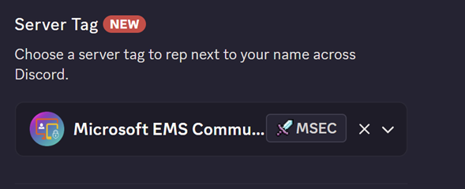
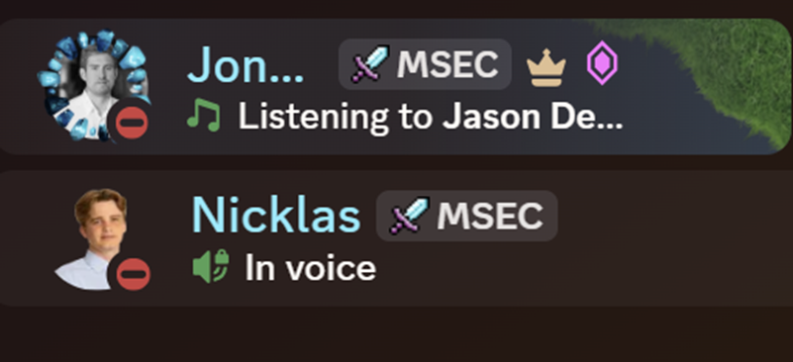
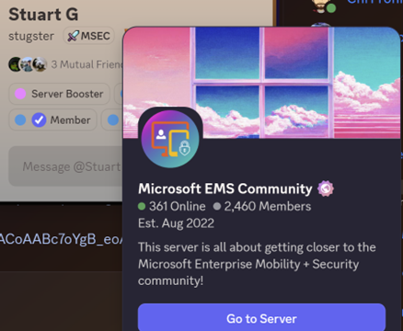
REP THE COMMUNITY
Add the MSEC server tag
1
Open Discord, then your profile
Click your name bottom-left, then Edit Profile.
2
Choose Server Tag
Pick Microsoft EMS Community from the list.
3
Wear it everywhere
The MSEC tag shows next to your name across Discord.
CloudHour · Microsoft EMS Community · Jul 2026
6
Notes:
Set the Microsoft EMS Community server tag in Discord. Join: https://aka.ms/M365EMSDiscord

Slide 4

TODAY'S AGENDA
On the table
We prepped two, then we open the floor. We will not get to all of them, so pick your battles.
1
Passkey by Default & SMS/Voice Disablement
LIVE
Entra ID · Identity
CloudHour · Microsoft EMS Community · Sept 2026
Notes:
Six topics, balanced across Intune, Entra, Defender and Purview, and across Windows, Android and iOS. Mandatory MFA (July 1) is on the radar board next.

Slide 5
TODAY'S AGENDA
On the table
We prepped two, then we open the floor. We will not get to all of them, so pick your battles.
1
Passkey by Default & SMS/Voice Disablement
LIVE
Entra ID · Identity
2
Entra Cloud Sync, Cloud-to-AD Provisioning
Live
Entra · Hyrbid
CloudHour · Microsoft EMS Community · Sept 2026
Notes:
Six topics, balanced across Intune, Entra, Defender and Purview, and across Windows, Android and iOS. Mandatory MFA (July 1) is on the radar board next.

Slide 6
TODAY'S AGENDA
On the table
We prepped two, then we open the floor. We will not get to all of them, so pick your battles.
1
Passkey by Default & SMS/Voice Disablement
LIVE
Entra ID · Identity
2
Entra Cloud Sync, Cloud-to-AD Provisioning
Live
Entra · Hyrbid
3
Open floor / AMA / Casual Cloudhour
Microsoft · topic from the crowd. Open floor, bring your own.
CloudHour · Microsoft EMS Community · Sept 2026
Notes:
Six topics, balanced across Intune, Entra, Defender and Purview, and across Windows, Android and iOS. Mandatory MFA (July 1) is on the radar board next.

Slide 7



TOPIC 1 · ROUND-TABLE
Passkeys by Default & SMS/Voice Retirement
The trigger
Since September 1, 2026, users enabled for SMS or voice are automatically enabled for passkeys and nudged to register after completing MFA.
Not enforced yet
The registration prompt can currently be postponed. The blocking experience starts after February 1, 2027 for users whose only available MFA method is SMS or voice.
The temp opt-out
Organizations can temporarily opt out through Microsoft Graph by setting passkeyDynamicMigration: true. This delays the automatic enablement and registration campaign, but does not provide an exemption from the February 2027 enforcement.
Critical nuance
Having another working MFA method reduces the immediate lockout risk, but Microsoft’s recommended destination remains a phishing-resistant method such as a passkey, Windows Hello for Business or a FIDO2 security key.

Slide 8
TOPIC 1 · ROUND-TABLE
Passkeys by Default & SMS/Voice Retirement
Is the temporary opt-out sensible change management, or are organizations simply postponing the inevitable?
Unmute and jump in. There are no wrong answers here.
CloudHour · Microsoft EMS Community · Sep 2026

Slide 9
TOPIC 1 · ROUND-TABLE
Passkeys by Default & SMS/Voice Retirement
Is the temporary opt-out sensible change management, or are organizations simply postponing the inevitable?
Who has already identified the users still depending on SMS or voice, and who is currently relying on the temporary opt-out?
Unmute and jump in. There are no wrong answers here.
CloudHour · Microsoft EMS Community · Sep 2026

Slide 10
TOPIC 1 · ROUND-TABLE
Entra Cloud Sync, Cloud-to-AD Provisioning
The Feature
Cloud Sync can provision users, security groups and group memberships from Entra ID into on-premises AD DS.
Context
Cloud Sync can run alongside Entra Connect Sync. It does not have to be an immediate all-or-nothing replacement.
Nested Group Pitfall
When a selected group contains another group, the nested group object is written back, but its members are not automatically included. The relevant member groups must also be placed in scope.
Important nuance
Group provisioning and user provisioning do not currently have the same maturity level. Group provisioning is generally available, while user provisioning is still in preview.
When a selected group contains another group, the nested group object is written back, but its members are not automatically included. The relevant member groups must also be placed in scope.
Notes:
Entra Cloud Sync, Cloud-to-AD Provisioning
The Feature: Entra Cloud Sync can provision users, security groups and group memberships from Entra ID into on-premises AD DS.
Maturity Matters: Group provisioning is generally available. User-only provisioning and combined user-and-group provisioning are still in preview.
Coexistence: Cloud Sync can run alongside Entra Connect Sync. It does not have to be an immediate all-or-nothing replacement.
The Direction: Group Writeback v2 in Entra Connect Sync is deprecated and no longer supported. Microsoft directs cloud security group provisioning toward Cloud Sync.
Nested Group Pitfall: When a selected group contains another group, the nested group object is written back, but its members are not automatically included. The relevant member groups must also be placed in scope.
OU Preservation: In the preview scenario where a group’s Source of Authority is converted to Entra ID, the GroupDN directory extension can preserve its original distinguished name for OU and CN mapping.
Important Nuance: Group provisioning and user provisioning do not currently have the same maturity level. Group provisioning is generally available, while user provisioning is still in preview.

Slide 11
TOPIC 2 · ROUND-TABLE
Entra Cloud Sync, Cloud-to-AD Provisioning
Does reverse provisioning help organizations leave AD behind, or does it make keeping AD easier?
Unmute and jump in. There are no wrong answers here.
CloudHour · Microsoft EMS Community · Sep 2026

Slide 12
TOPIC 2 · ROUND-TABLE
Entra Cloud Sync, Cloud-to-AD Provisioning
Does reverse provisioning help organizations leave AD behind, or does it make keeping AD easier?
Is anyone already running Cloud Sync alongside Entra Connect Sync for Entra-to-AD provisioning?
Unmute and jump in. There are no wrong answers here.
CloudHour · Microsoft EMS Community · Sep 2026

Slide 13

OPEN FLOOR
Topic from the crowd
Your turn. What is eating your week, what broke this month, and what do you want to ask anyone in the room?
What is your biggest EMS headache right now?
A win worth sharing with the room?
The floor is yours. Unmute and go.
CloudHour · Microsoft EMS Community · Sept 2026
21
Notes:
Open floor. Capture next month topic ideas in chat.

Slide 14
MICROSOFT EMS COMMUNITY
Thank you
for joining CloudHour. See you next month (digitally), and bring a colleague.
aka.ms/M365EMSDiscord
msems.community
Independent and community-run. Not affiliated with, endorsed by, or sponsored by Microsoft. Product names are trademarks of the Microsoft group of companies.
Notes:
Wrap up. Discord https://aka.ms/M365EMSDiscord and https://www.msems.community/

